Slide 1
CO326
Computer Systems Engineering: Industrial Networks
Smart Building Project:
Group F (Photovoltaic System)

Slide 2
Presentation Flow
Introduction
High-Level Overview
Hybrid Inverter - The Black Box
Our Design
Components
PV Cell
Battery Pack
MPPT Charge Controller
Digital to Analog Converter
Sensors and Actuators
Taking Decisions using SCADA
Displaying Data on SCADA
Taking Control Action Using SCADA
Process Optimization and Control algorithms
Storage and Database Implementation
Displaying Data from Database in SCADA
Data analysis and predictions
Prototype Presentation

Slide 3
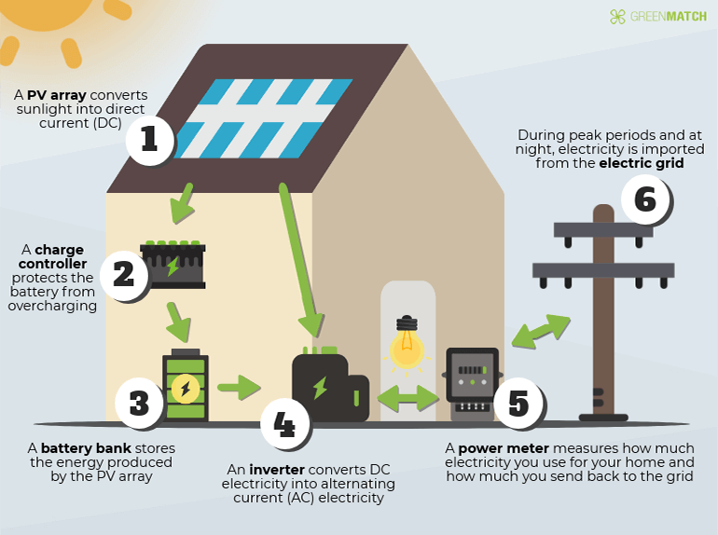
Introduction
Notes:
PV system is a renewable energy system which converts solar power into electricity using photovoltaic cells.
It provides a greener,sustainable and low maintenance system to the building.
PV converts solar energy into DC electricity, then that generated energy should be converted into AC electricity using an inverter.
Photovoltaic systems generally consist of six individual components:
the solar PV array
a charge controller
a battery bank
an inverter
a utility meter
an electric grid.

Slide 4
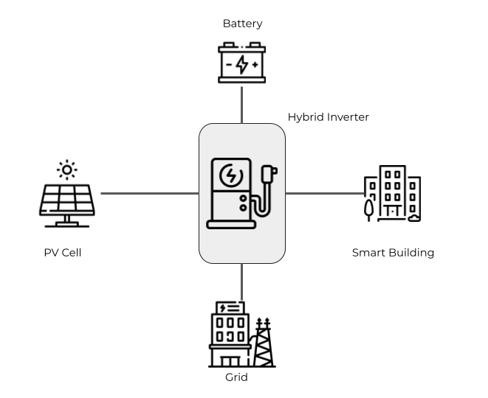
High-level Overview

Slide 5
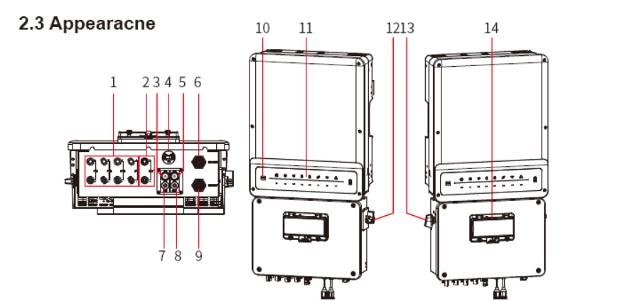
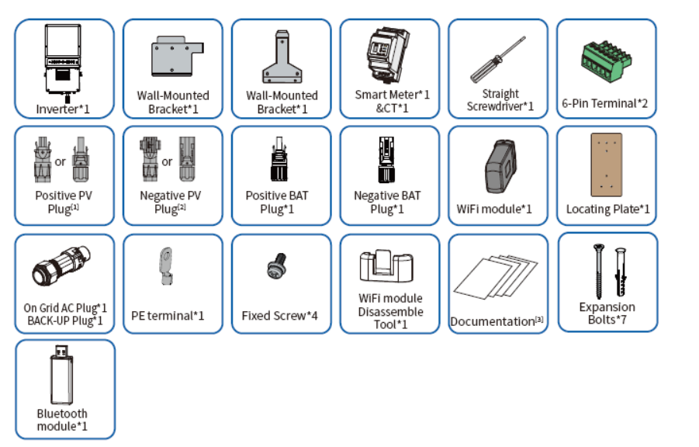
Hybrid Inverter the Black Box
Ex - GEH5.0-1U-10 Hybrid Inverter
Inverter
Implementation of Sensors,actuators
and taking Control actions
happen inside this box.
All actions are proprietary
Normally a Hybrid Inverter
Control the Battery Charger
AC to DC conversion and DC to AC Conversion
Switching between Battery and the Grid Current

Slide 6
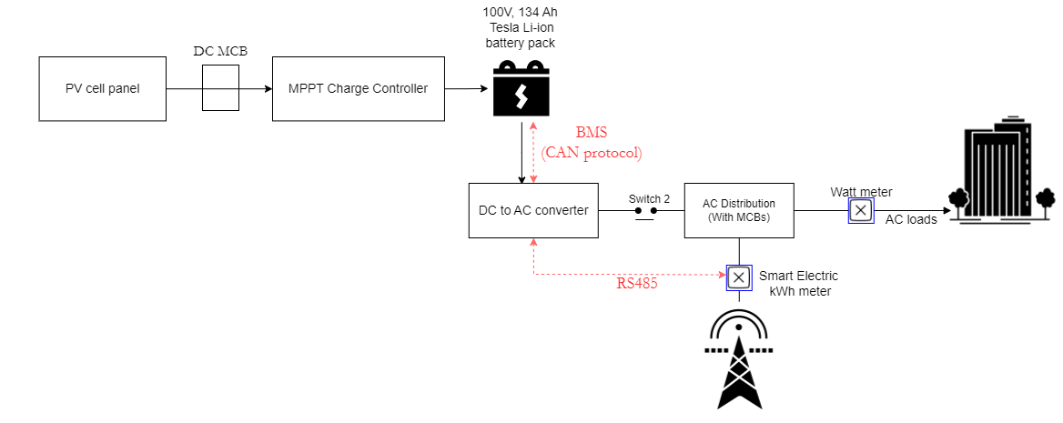
Our Design
Notes:
The hardware components are shown above individually together with the actuators.
Different forms of communication between hardware components are not necessary here
SCADA system is utilized for monitoring and all the controlling.
The actuators can be controlled by sending sensor data to the SCADA system and receiving control signals in return.
Only MQTT is required to interact with SCADA in order to send sensor data and receive control signals to operate actuators.
For MQTT connection separate circuitry with ESP8266 IC is used.
The SCADA system processes the sensor data that was received over MQTT, and then sends back the control decisions to the MQTT server.
The ESP8266 IC which is connected to the actuators can read the published messages through relevant subscribed topics and generate the corresponding control signals.

Slide 7
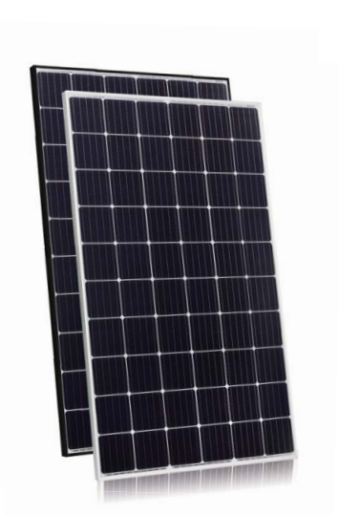
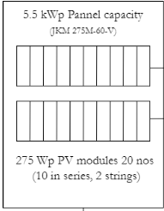
Components - PV Cell
Eagle 60M 275-295 Watt MONO CRYSTALLINE MODULE - JKM275M-60V
Operating Temperature - -40C to +85C
Maximum Output Power - 275Wp
Maximum Output Voltage - 31.6v
Maximum Output Current - 8.71A
*http://jinkosolar.com.au/wp-content/uploads/2019/03/Eagle-JKM275-295M-60-V-A2-EN.pdf
We are using 20 such PV cells therefore
33m² of Module area
Number of Inverters - 1
Nominal PV power - 5.5kWp
Nominal AC power - 5.0kWAC

Slide 8
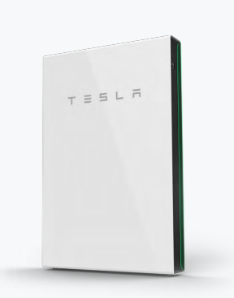
Components - Battery Pack
Tesla Li-Ion Battery
Operating Voltage - 50.4v
Weight - 97 kg
Number of Cycles - 1475 Cycles
Stored Energy - 5.4kWh.
Charging Time Duration on Full Sun Conditions - 2 hours
In our Implementation We are using two cells in Series, Therefore
Weight - 194 Kg
Stored Energy - 10.8kWh

Slide 9
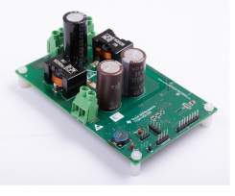
Component - MPPT Charge Controller
Solar charge controller (SCC) with MPPT consists of DC-DC Converter and MPPT algorithm.
It utilizes the output of the PV panel (i.e., the voltage and current) to produce the pulse width modulation (PWM) signal to control the boost converter’s output.
MPPT-SCC can transfer more than 90% of the PV panel power to the battery.
To connect a battery with a different operating voltage in comparison to the MPP of the panel, a buck converter must be used

Slide 10
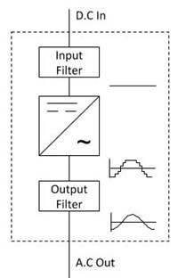
Component - Digital to Analog Converter
The DC to AC converter is used to convert the DC power stored in the battery to AC to be directed to the AC loads in the smart house.
A transformer coil system & a switch is the simple circuit used for an inverter. A typical transformer can be connected toward the DC signal input through a switch to oscillate back quickly.
Due to the current flow in bi-directional in the primary coil of the transformer, an alternating current signal is an output throughout the secondary coils.

Slide 11
Sensors and Actuators
Sensors
PV Voltage Sensor - Hiletgo Voltage Detection Module (Simulated)
PV Current Sensor ACS712 Current Sensor (Simulated)
Battery Current Sensor ACS712 Current Sensor (simulated)
Battery Voltage Sensor Hiletgo Voltage Detection Module(simulated)
Smart Meter ACS712 Current Sensor(Implemented)
Actuators
Switch 1 - Relay 5v 1-channel Relay(Simulated)
Switch 2 - Relay 5v 1-Channel Relay(Implemented)

Slide 12
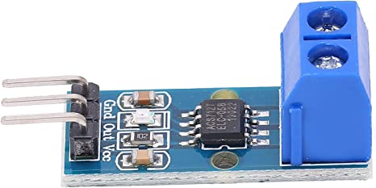
Sensors and Actuators
ACS712 Current Sensor
This sensor is connected in series nature to the AC connection, Which Indicated the Current Availability in the grid.
The Sensor value is read through the analog pin (A0) of ESP8266 IC
ESP8266 is connected to the Node-red Server through wifi
After processing the data itself within the ESP8266 the current availability signal is send to the node red server via MQTT
Advantages
Use the Principle of Hall effect therefore the DC components are isolated from the AC Components
Can be used for both AC and DC
Low Noise and Low Resistance

Slide 13
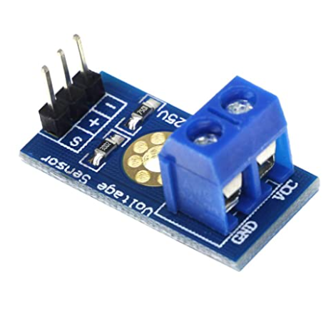
Sensors and Actuators
Hiletgo Voltage Detection Module
Voltage Detection Sensor Module is a simple and very useful module that uses a potential divider to reduce any input voltage by a factor of 5. This allows us to use the Analog input pin of a microcontroller to monitor voltages higher than it capable of sensing. For example, with a 0V - 5V Analog input range, you are able to measure a voltage up to 25V. This module also includes convenient screw terminals for easy and secure connections of a wire.
Advantages and Specifications
Input Voltage Level 0-25v
Voltage Detection Range: 0.02445 to 25
Analog Voltage Resolution: 0.00489V
Needs no external components
Easy to use with Microcontrollers
Dimensions: 4 × 3 × 2 cm

Slide 14
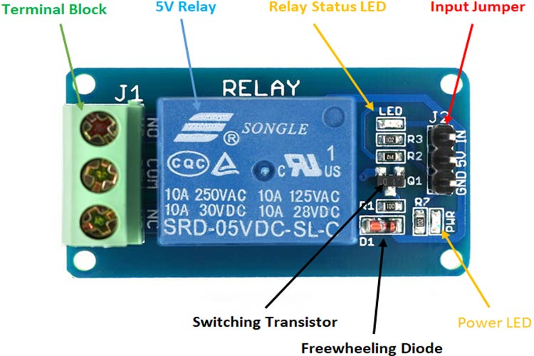
Sensors and Actuators
5V 1-Channel Relay
The single-channel relay module contains components that make switching and connection easier and act as indicators to show if the module is powered and if the relay is active.
Supply voltage - 3.7V to 6V
Relay maximum contact voltage - 250VAC or 30VDC
Relay maximum current - 10A
This relay is used in both the switches
First Switch is there to charge the Battery
Second Switch is used to switch between the battery power and grid power

Slide 15
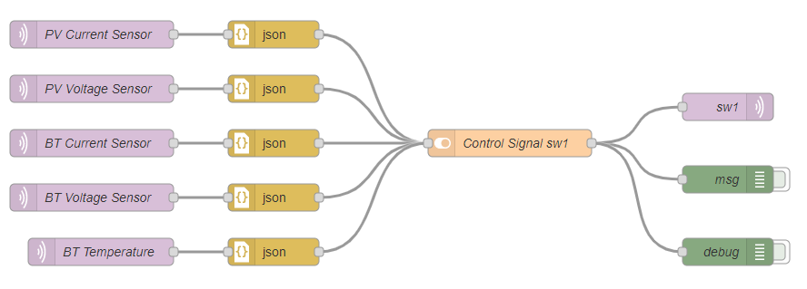
Taking decisions using SCADA
PV Current Sensor,PV Voltage Sensor,Battery Current Sensor and BT Voltage Sensor are simulated using a python script and those data are injected into SCADA,
In the real world MPPT(Maximum Power Point Tracking) is the mechanism that is used to charge the battery.(in Prototyping PWM Charge Controller Algorithm is used)
According to that mechanism the charging of battery is done.
Switch 1 is used to charge the battery.

Slide 16
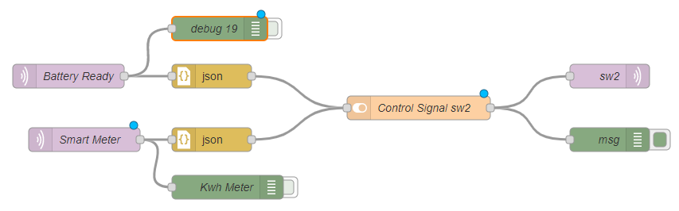
Taking decisions using SCADA
Switch 2 is used to switch between the battery power and grid power,
Battery ready is generated by a python script running on a thread,
Smart Meter reading is taken using the ACS712 current sensor
Those two inputs are used to determine the output of switching between battery power and grid power

Slide 17
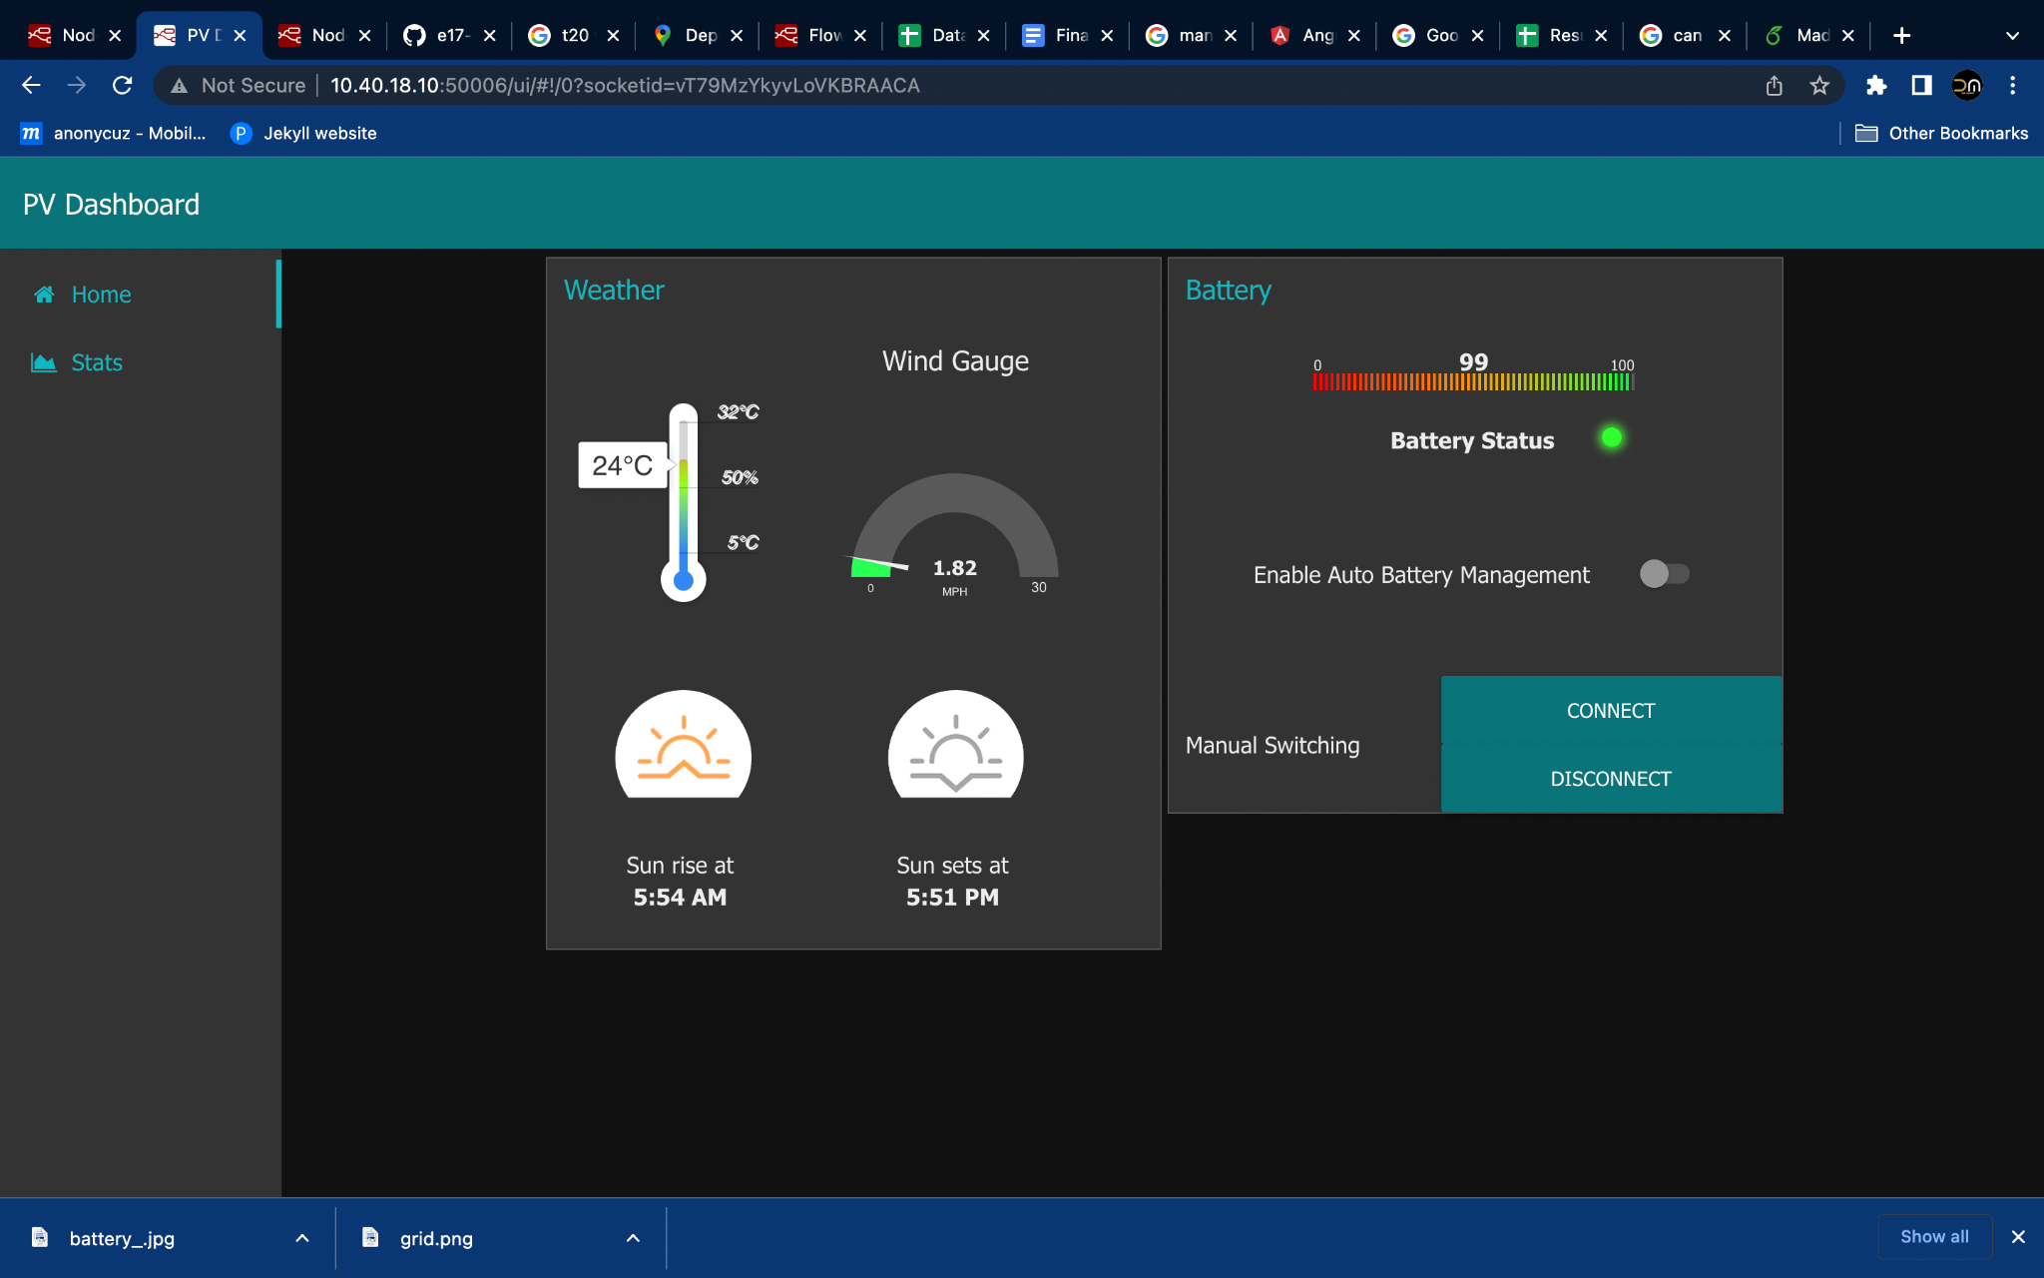
Displaying Data in SCADA

Slide 18
Taking Control action using the SCADA
We have two modes in the SCADA
Auto mode
Manual mode
In the Auto mode all the actions happen automatically but when the battery level is less than 60% we can use the manual mode to operate with the battery as well.
In the manual mode the battery can either
Connected
Disconnected

Slide 19
Process Optimization and algorithms
Notes:
Maximum power point tracking (MPPT) is an algorithm implemented in photovoltaic (PV) inverters to continuously adjust the impedance seen by the solar array to keep the PV system operating at, or close to, the peak power point of the PV panel under varying conditions, like changing solar irradiance, temperature, and load.

Slide 20
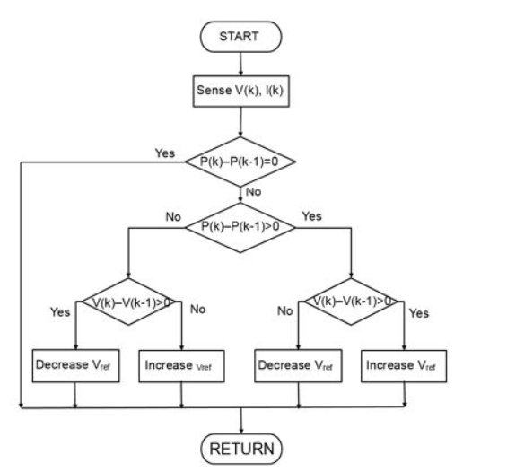
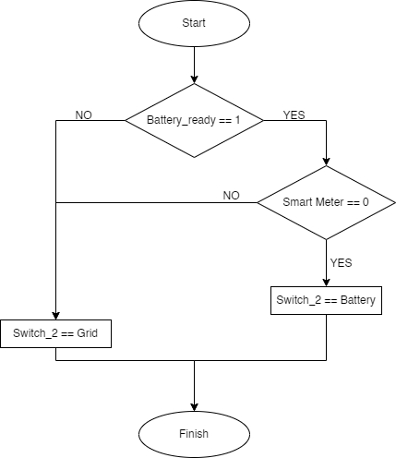
Process Optimization and algorithms
For Switch 1
For Switch 2
Notes:
Perturbation and observation (P&O): This algorithm perturbs the operating voltage to ensure maximum power. While there are several advanced and more optimized variants of this algorithm, a basic P&O MPPT algorithm is shown below.

Slide 21
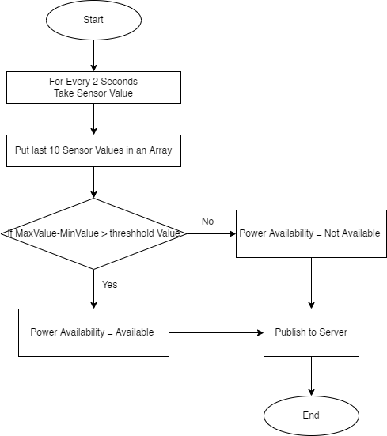
Process Optimization and algorithms
For Smart Meter Sensor

Slide 22
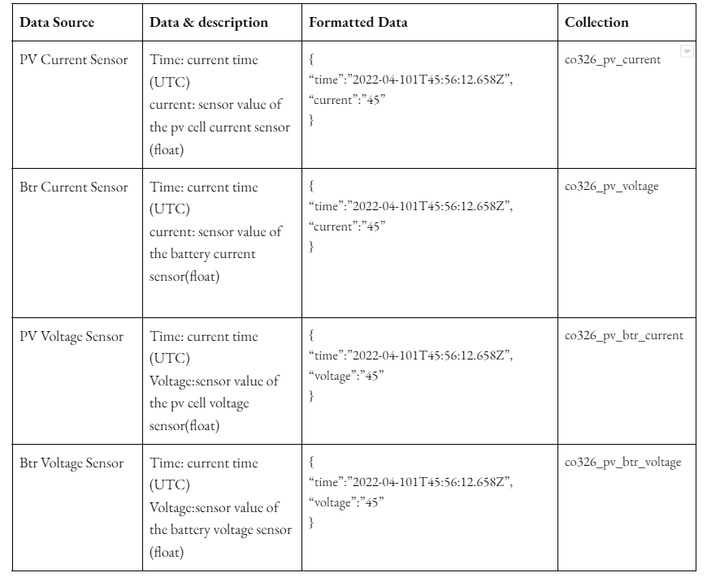
Storage and Database Implementation

Slide 23
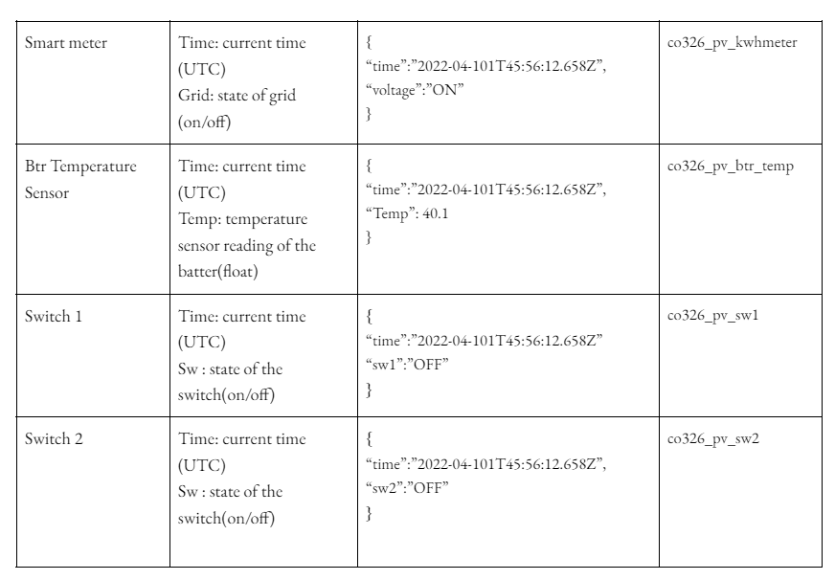
Storage and Database Implementation

Slide 24
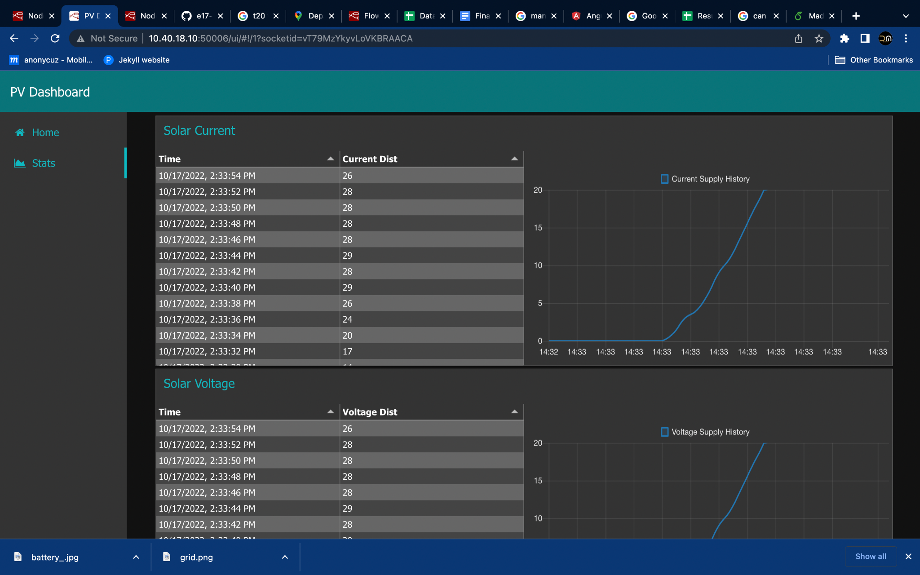
Display Of Data from the Database

Slide 25
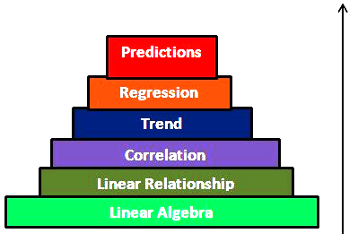
Data Analytics

Slide 26
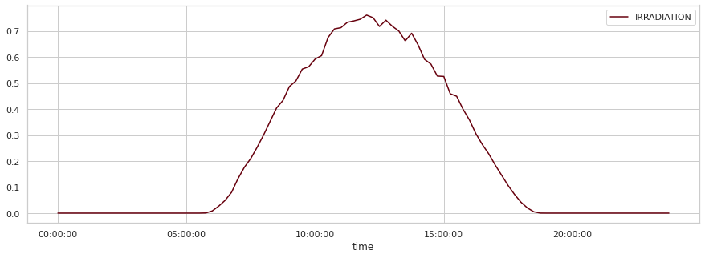
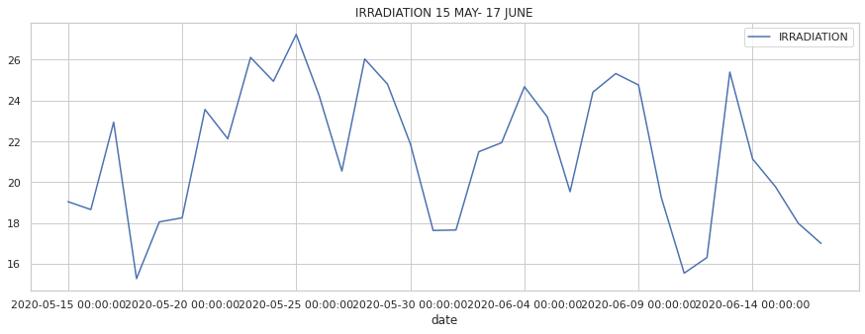
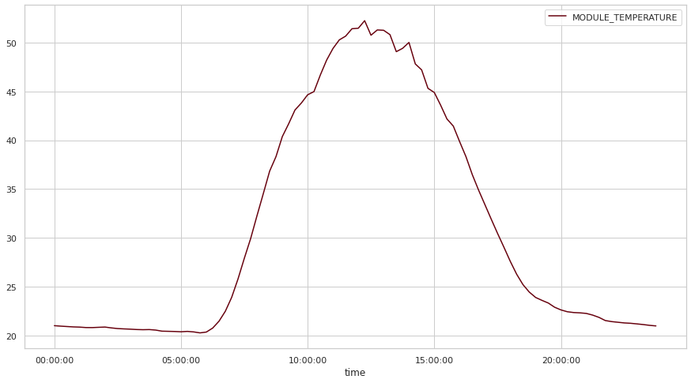
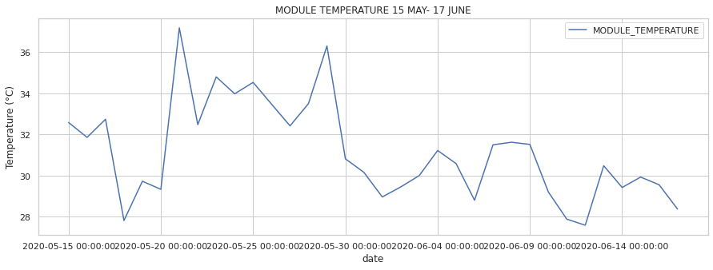
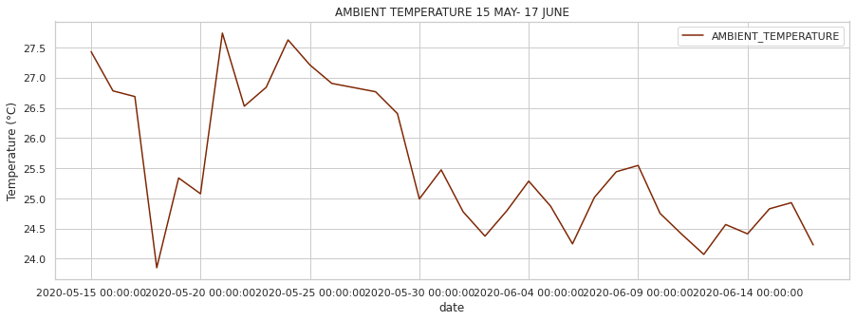
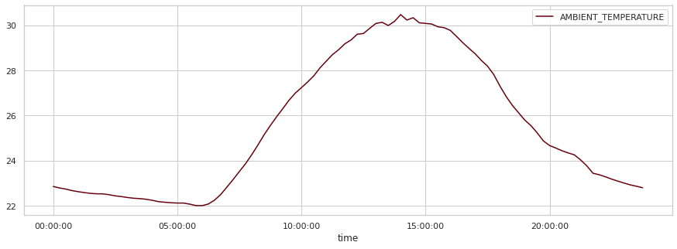
Trends in weather sensor data
Plots of Time vs Average Data
Plots of Date vs Average Data

Slide 27
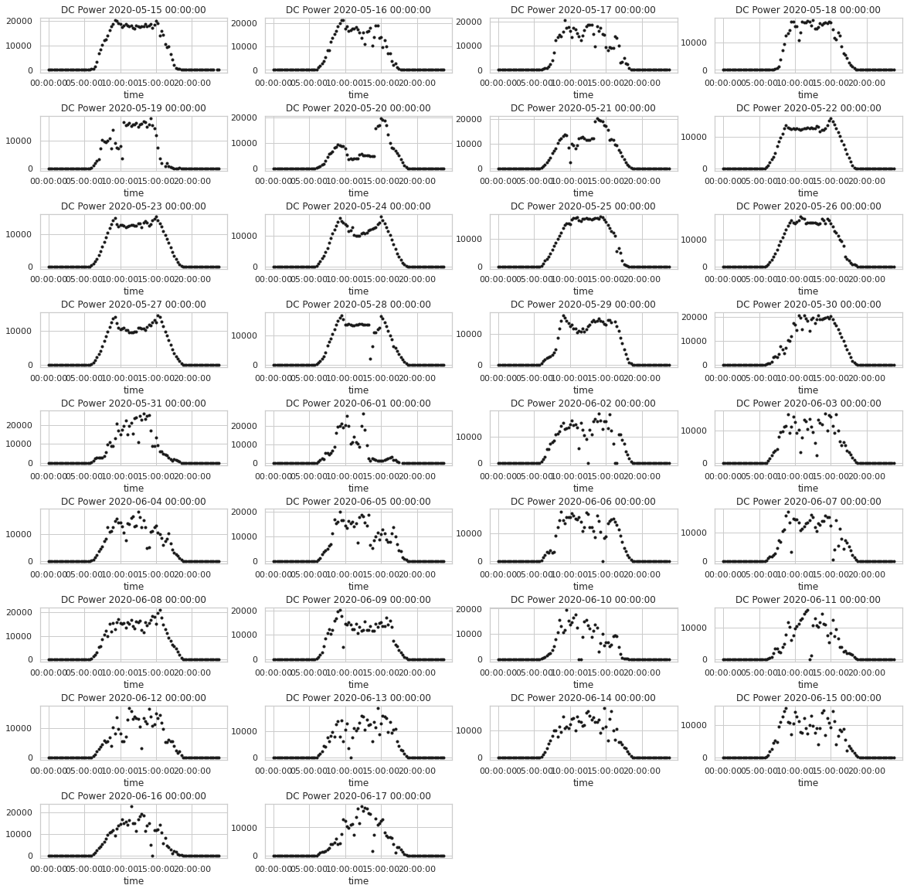
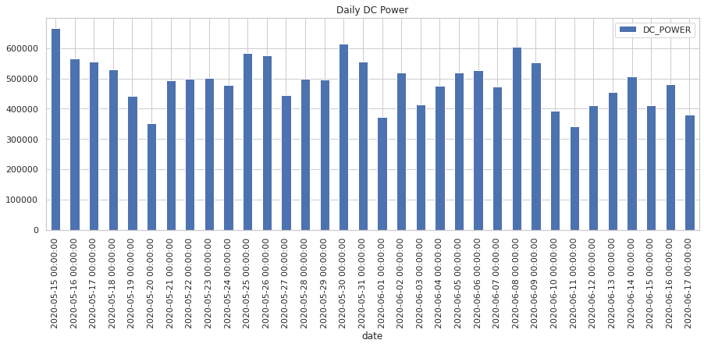
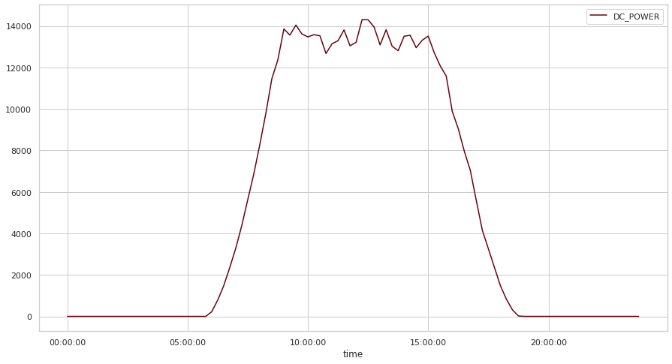
Trends in Power Generation Data
Daily Average DC Power Generation
Daily DC Power Generation During a Period of 1 Month
Average DC Power Generation in a Day

Slide 28
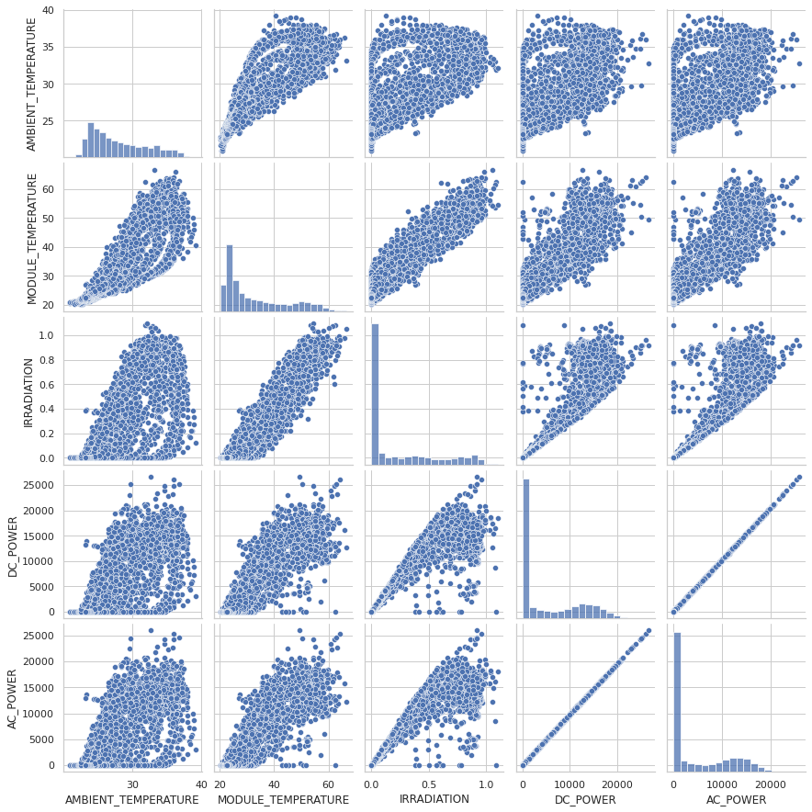
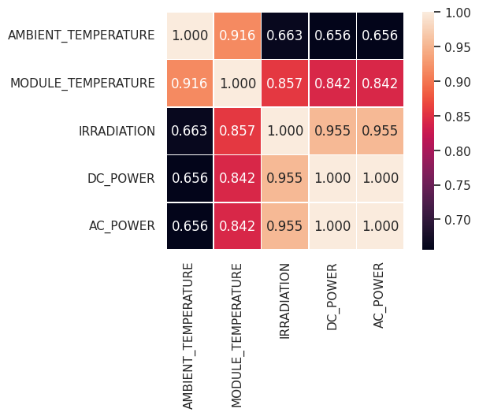
Correlation
Cross Correlation Matrix for the Spearman Coefficient
Cross Correlation Pairplots

Slide 29
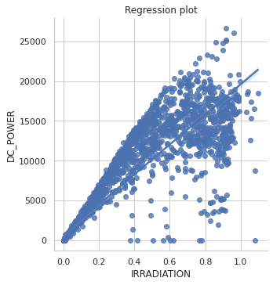
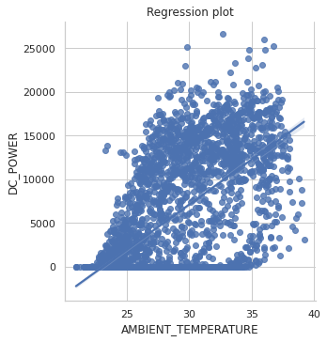
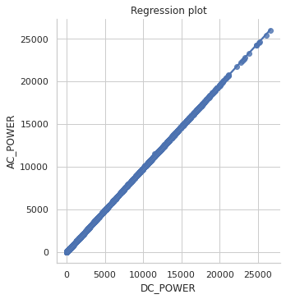
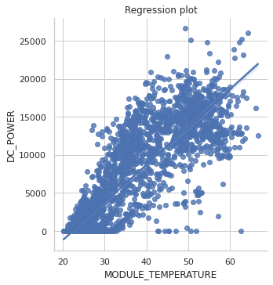
Correlation
Conclusion based on the correlation of data.
1. The transfer function between dc and ac power is linear.
2. DC power is indeed influenced by the ambient temperature, by the temperature of the module, by the irradiation and finally by the heat transfer between the module and the air.
3. Inverters of Plant I lost 90% of their dc power when it convert.
Notes:
Conclusion based on the correlation of data.
1. the transfert function between dc and ac power is linear.
2. dc power is indeed influenced by the ambient temperature, by the temperature of the module, by the irradiation and finally by the heat transfer between the module and the air.
3. Inverters of Plant I lost 90% of their dc power when it convert.

Slide 30
Prediction
Method used : Multiple Linear Regression Machine Learning model
Parameters used: Module Temperature and Solar Irradiation
Training data size: 2281
Test data set size: 978
Result: 0.84 coefficient of determination (84% accuracy)
These predictions can be used;
To predict the DC power generation for hypothetical values of irradiation and module temperature.
To measure the expected level of DC power generation, compare it with the actual DC power generation and use those results as a measure of the performance of the photovoltaic system.
To predict power generation in the future if the weather sensor data can be predicted ahead of time.

Slide 31
Implementation - Prototyping Level

